Slide 1



Lecture 8
Chemical Engineering for Micro/Nano Fabrication
Matt Colburn Steve Johnson S.V. Sreenivasan
Step and Flash Imprint Lithography

Slide 2
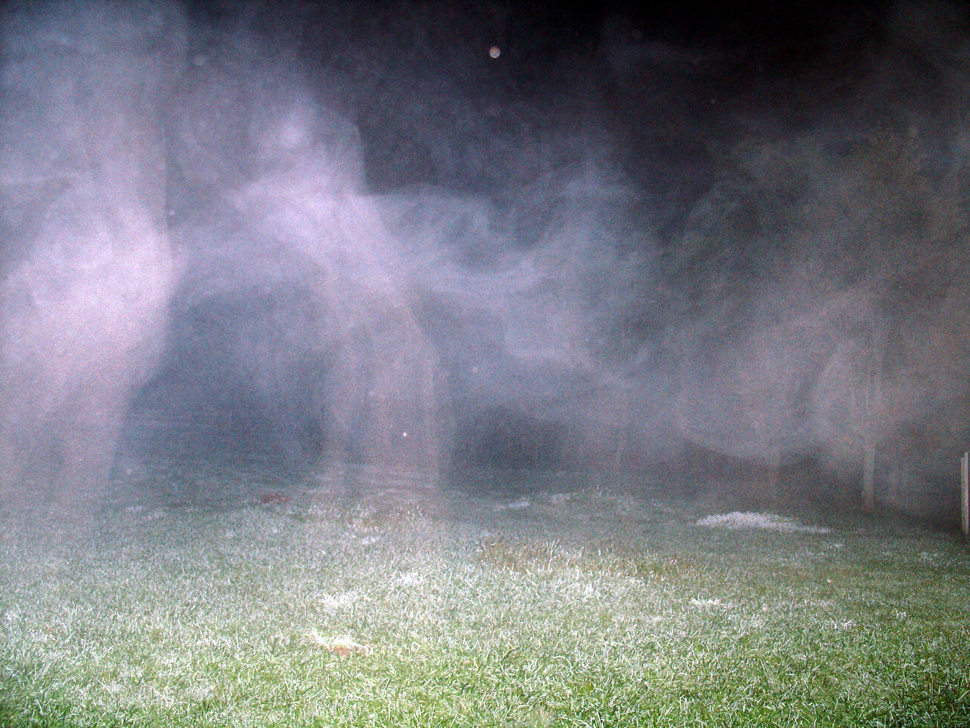
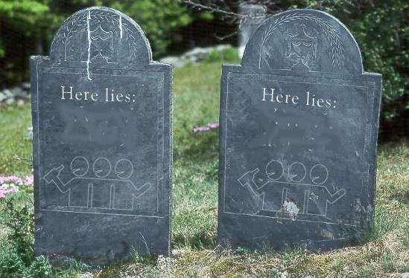
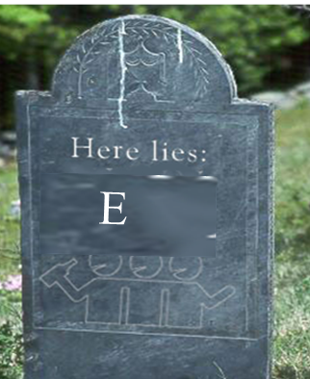
Let’s look more closely in the graveyard
157nm
X-ray
X-ray

Slide 3
We need “tweaks”, or EUV or NGL
We need …..something!!
Tweak also means to adjust or fine-tune. When you finish writing a paper, it's a good idea to go back through one last time, to tweak it and make sure it's absolutely perfect. So when you tweak something or give something a tweak, you're making little adjustments, you’re not rewriting your paper or tossing it out and starting all over again.
When you tweak something, you pinch it or twist it. You may have a doting aunt who thinks you're still two years old and can't resist tweaking your nose every time she sees you.

Slide 4
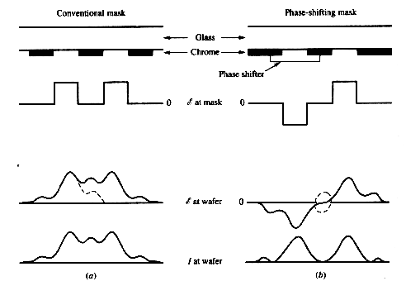
Phase Shifting Principle
Conventional Mask
Phase Shifting Mask
d
Phase Shifter
Amplitude
at Mask
d = 0.5λ/(n-1)
Amplitude
at Wafer
Intensity
at Wafer
Notes:
Shifting the phase by 180 degrees is equivalent to changing the sign of the amplitude.
The conventional binary mask only controls the magnitude of the amplitude, not its sign whereas a phase shifting mask controls both amplitude and sign. Allows for amplitudes of opposite signs on opposite sides of each narrow, opaque, mask feature.
Can use destructive interference to cancel some of the image spreading effects of diffraction.
Net result is a remarkable increase in contrast for fine dark features accompanies by a 180°phase shift – also DoF.
Exact degree depends on the degree of partial coherence For current illumination systems with σ =0.5, the DoF improvement is about 2.

Slide 5
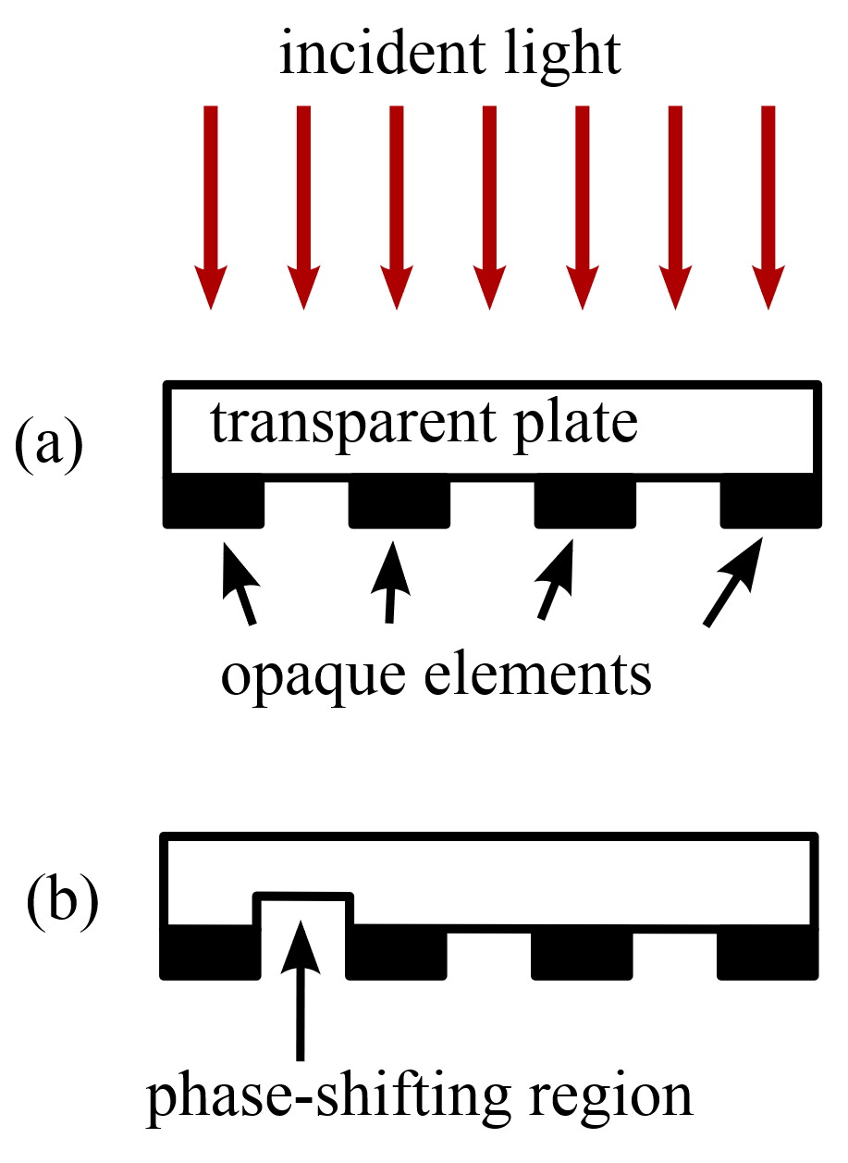
Phase Shifting Mask
https://spie.org/publications/fg06_p78-80_phase-shift_masks

Slide 6

Laying out Levenson Masks

Slide 7
Wavefront Engineering: Direction
Off-Axis Designs
  Annular
  Quadrupole
  Dipole
or
+
Eliminates on-axis zero order light - increases contrast
Notes:
With off-axis, illumination, the image is formed by the interference of the first-order and zero-order beams (Two Beam imaging). Both beams are subject to phase differences in a defocus position, impacting contrast.
The phase difference is given by the radial position in the in the lens pupil.
Because of the off-axis character of the illumination, this difference will be less when compared to normal on-axis illumination.
In the limiting situation, the first-order and zero-order beams have the same radial position., hence the contrast degradation in defocus will be minimal. For σ = 0, the contrast degradation will be zero.
In practical systems, the intensity distribution in the lens pupil must be radially symmetric. Deviations will result in an unwanted non telecentric system. This is the case with annular and quadrupole illumination.
Annular provides isotropic improvement in resolution. The others provide directional improvement.

Slide 8
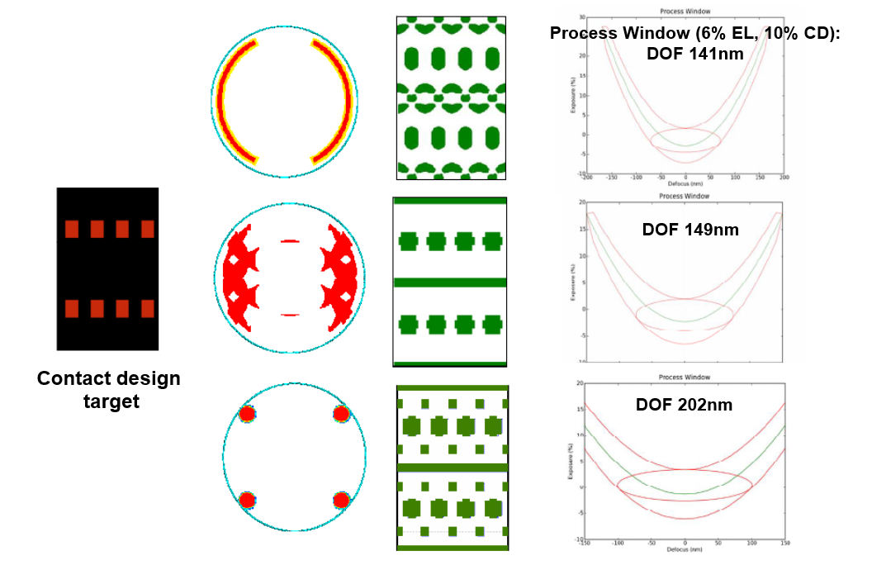
Some mask / illuminator options

Slide 9
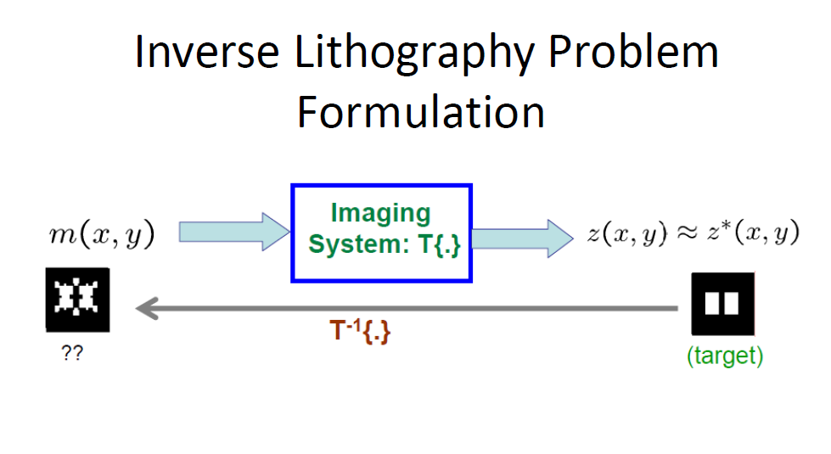

Slide 10

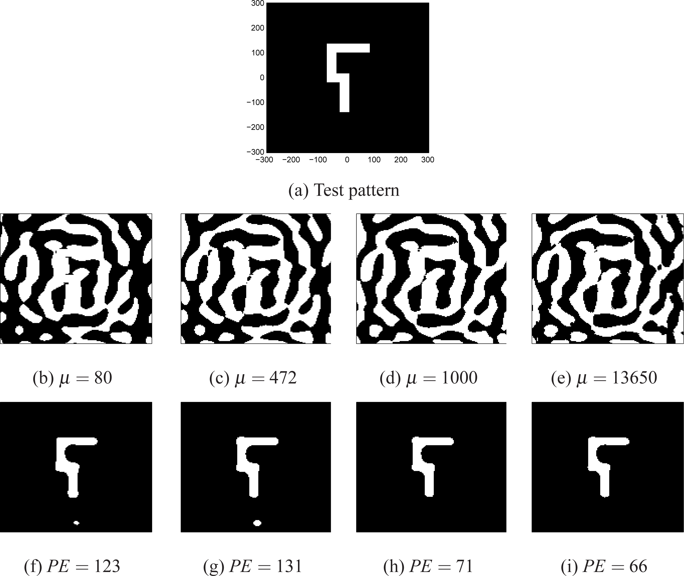
Inverse Lithography
https://www.osapublishing.org/oe/abstract.cfm?uri=oe-21-7-8076

Slide 11
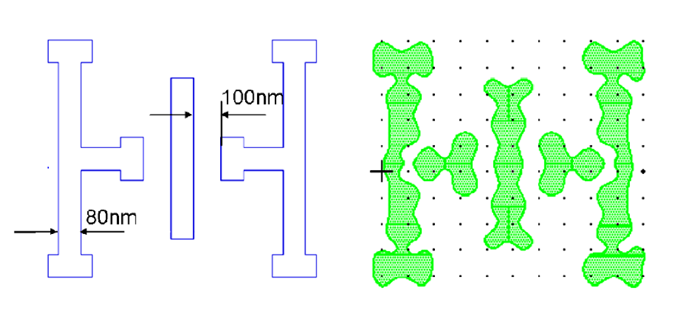
Some Unintuitive Shapes
Very complex mask patterns are emerging
  Curved shapes…..very slow to write.

Slide 12
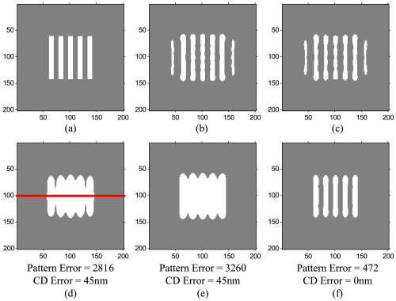
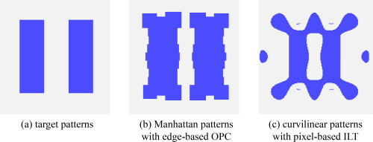

Slide 13
Inverse Lithography
Makes the OPC and design people very happy
Very complex mask patterns are emerging
  Curved shapes…..very slow to write.
But….the savior is on the way!
  IMS, has morphed into a multibeam mask writer!!
  First tools are to be delivered “now”…
  262 beams, 12G/sec data path, air bearing vacuum stage (?)
  DNP has tested this and is very high on the tool

Slide 14
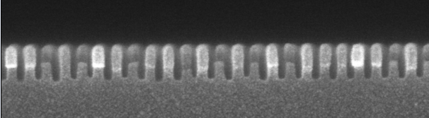
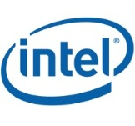
Only remaining option is double exposure?
$
$
20nm lines and spaces
+
=

Slide 16
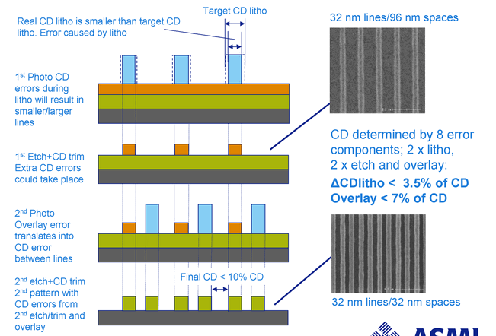
Litho-Etch-Litho-Etch LELE
y

Slide 17
57.8 nm pitch

Slide 18
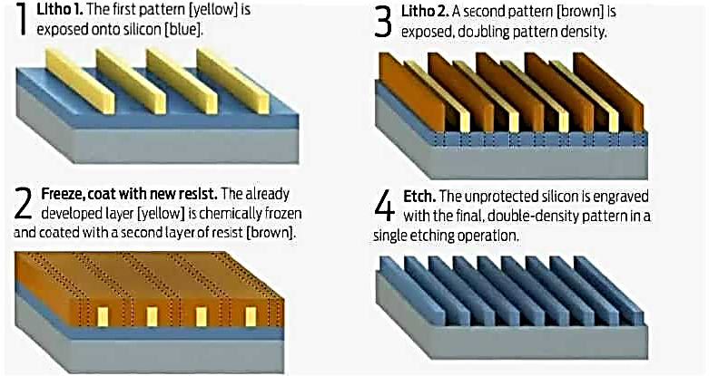
Litho Freeze Litho Etch - LFLE

Slide 19
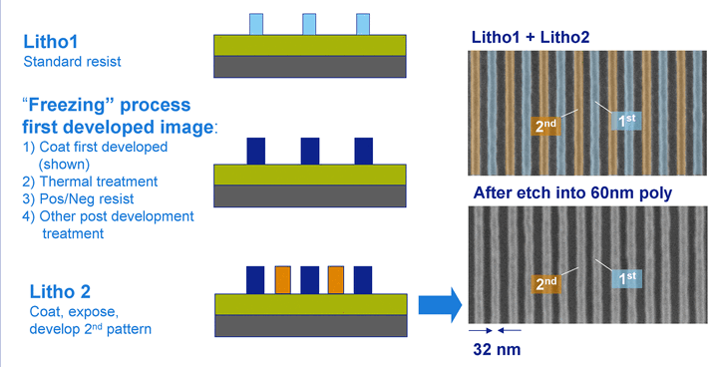
Litho-Freeze-Litho-Etch LELE

Slide 20
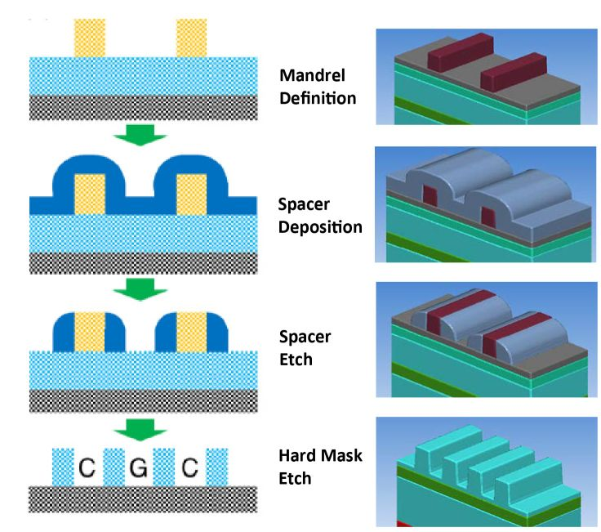
SADP Process

Slide 21
Some Issues…

Slide 22
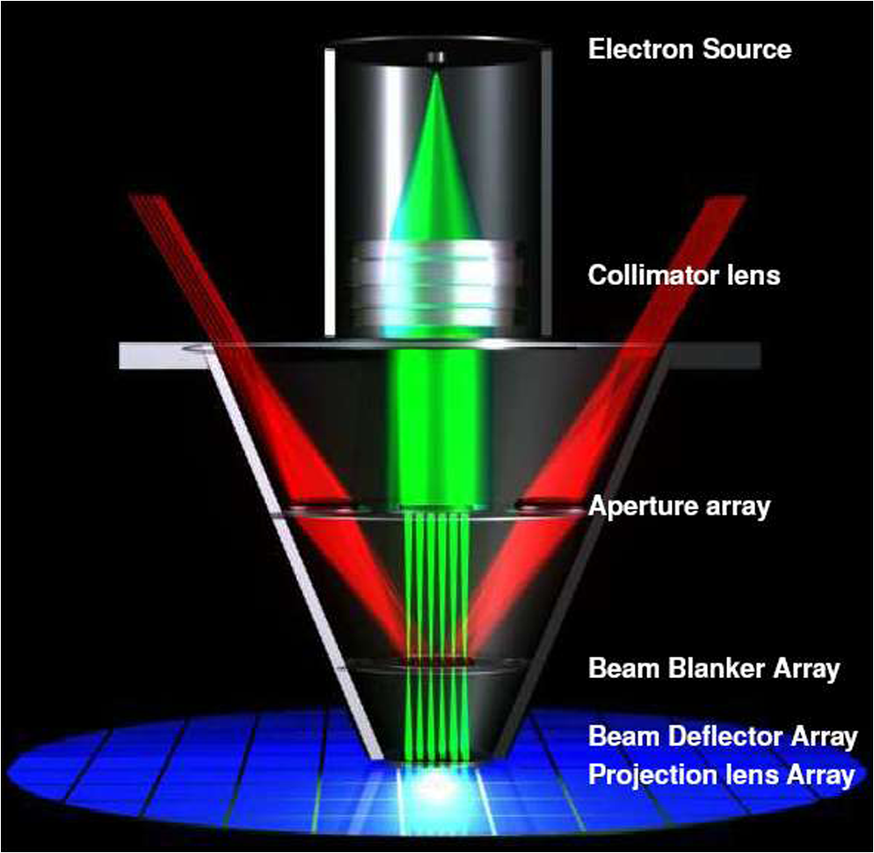
IMS eMET Mask Writer Tool

Slide 23
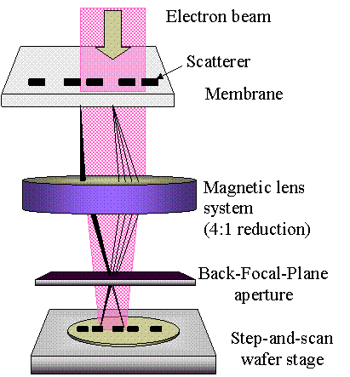
SCAPEL
(SCattering with Angular Limitation Projection Electron-beam Lithography)

Slide 24
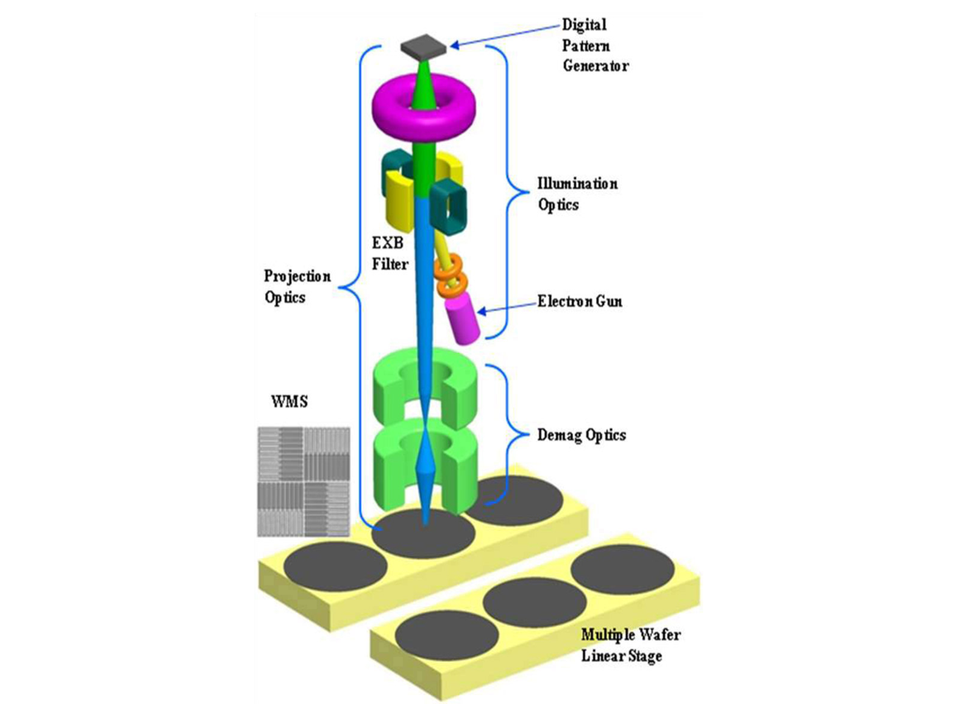
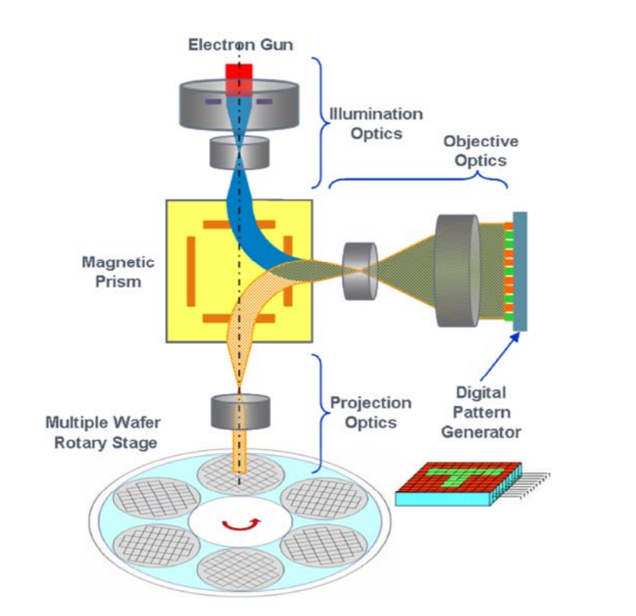
REBL

Slide 25
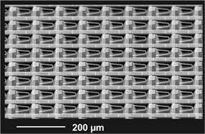
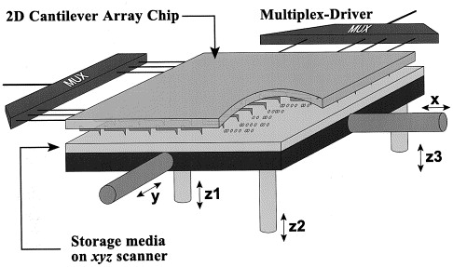
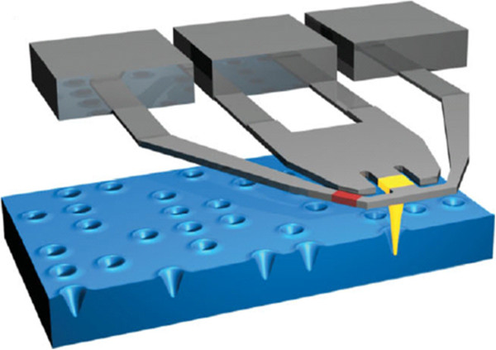
IBM Millipede

Slide 26
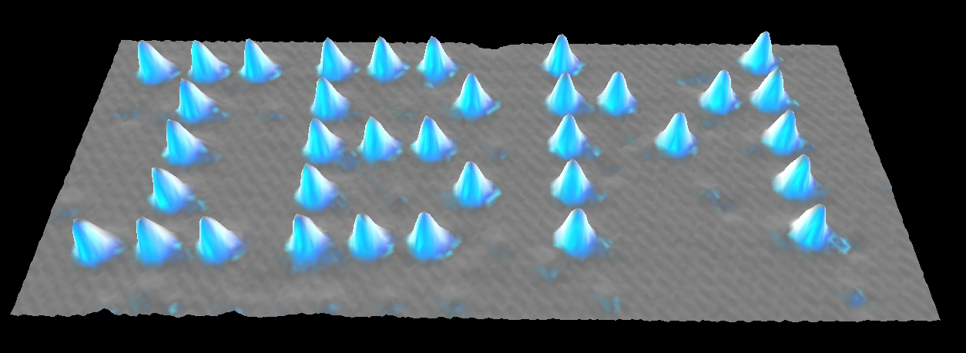
Ultimate limit of high resolution patterning!!
1 atom
0,438 nm
Eigler, et al IBM Almaden
Xe on Nickel
Notes:
There is a limit to resolution and this is it…one atom

Slide 27
Atomic Resolution…atom by atom
Resolution:
1 atom ~ 0.3–0.5nm
Throughput:
  one atom per minute
  ~ 0.02 pixels/second
Great Science but not yet practical
Don Eigler
IBM Almaden Research Center

Slide 28
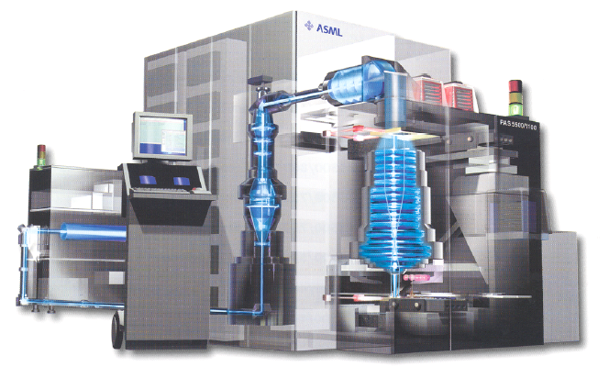
Production Lithography
193nm step and scan exposure
Chemically Amplified Resist
Water immersion lithograpy
Cost > $60 million/tool
Resolution: 40 nm ≈ λ/5
Throughput: 100 wafers/hr
>300 gigapixels/sec!!!
OK…Serial Processes are Simply too Slow

Slide 29
Resolution vs. Throughput
Shaped & cell projection E-beam lithography
Other Gaussian E-beam lithography (high speed resists)
AFM (single tip with Silicon as resist)
Resolution (Angstrom)
E-beam lithography
(inorganic resists)
Gaussian E-beam lithography
(PMMA resist)
Imprint
←STM- atom manipulation
10⁻⁶
10⁻⁴
10 ²
10⁴
10¹²
10⁻²
10⁰
10⁶
10⁸
10¹⁰
Don Tennant: Cornell University
Area Throughput (μm²/hr)
Notes:
This plot from Professor Tennant at Cornell shows that all high resolution printing methodologies fall on a line in a log-log plot that relates throughput to resolution. The single atom experiment is in the lower left….very slow, but high resolution. Optical lithography I in the upper right. There is one technique that does not fall on this line. That is imprint so we were inspired to explore this technology.

Slide 30
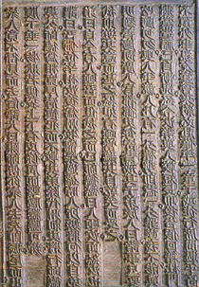
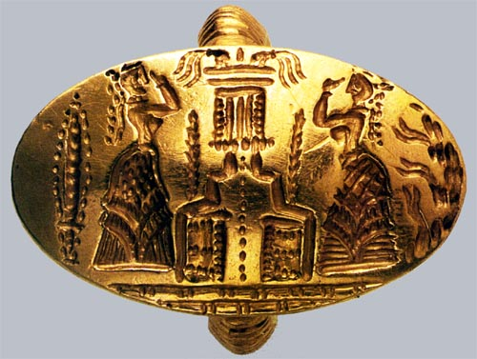
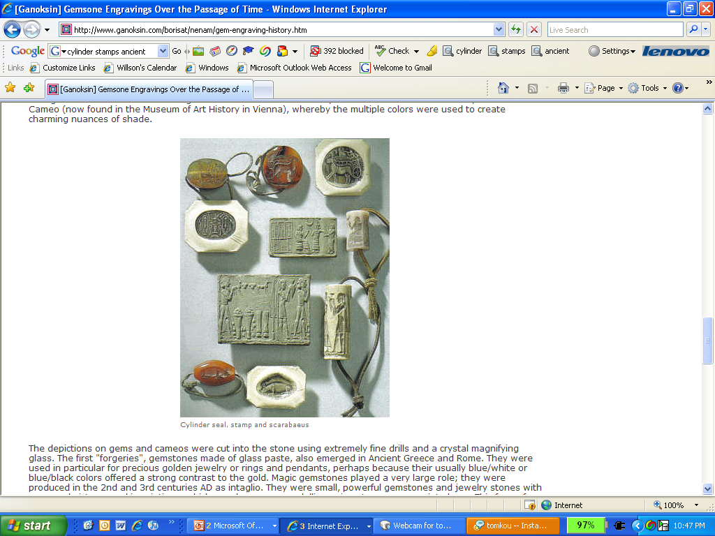
600 AD Imprint Lithography
Minoan Signet Ring
From the Bronze Age
Tang Dynasty Templates
Mesopotamian Templates

Slide 31
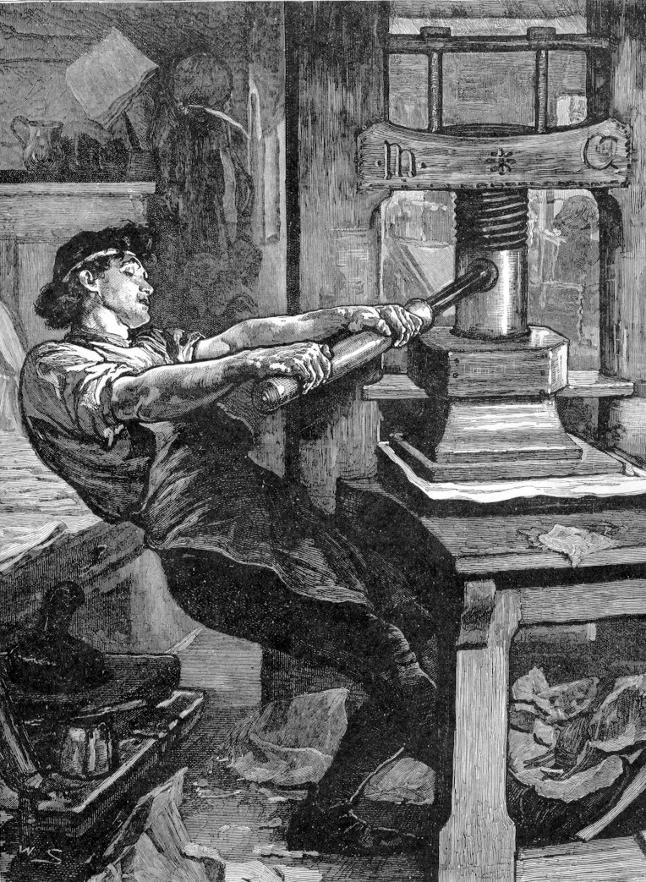

15th Century Imprint Lithography
JOHANNES GUTENBERG

Slide 32
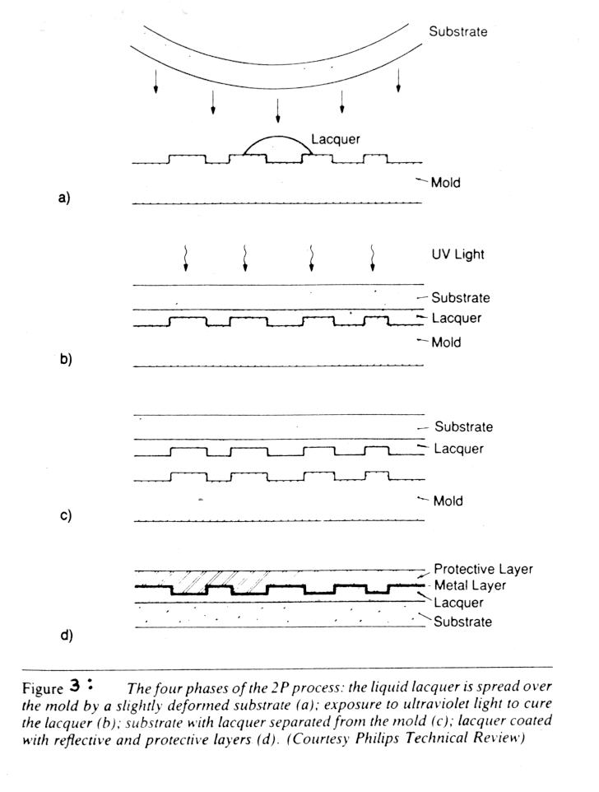
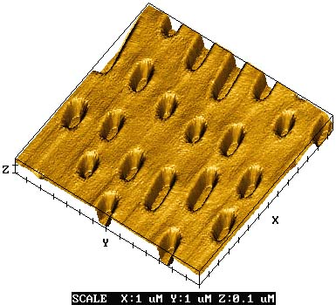
1980’s Nanoimprint for CDs
Phillips 2P process
  UV sensitive “lacquer” sandwiched between mold and thin polycarbonate substrate
  UV light shown through substrate to cure lacquer

Slide 33
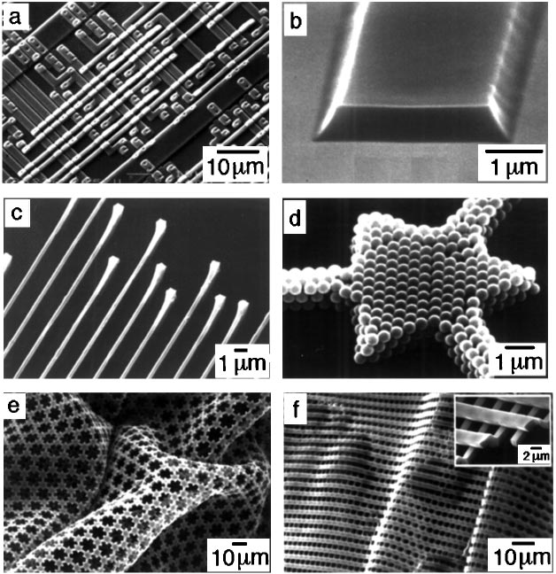
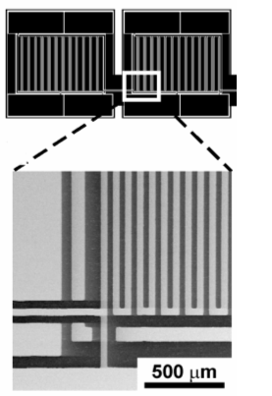


90’s Soft Lithography
Soft Lithography
1. PDMS template with thiol
2. Imprint stamp
3. Transfer molecules
4. Pattern Transfer
Younan Xia and George M. Whitesides
Annu. Rev. Mater. Sci. 1998. 28:153–84

